Slide 1
Types of holidays and Leisure Activities
Mariam Anjaparidze

Slide 2
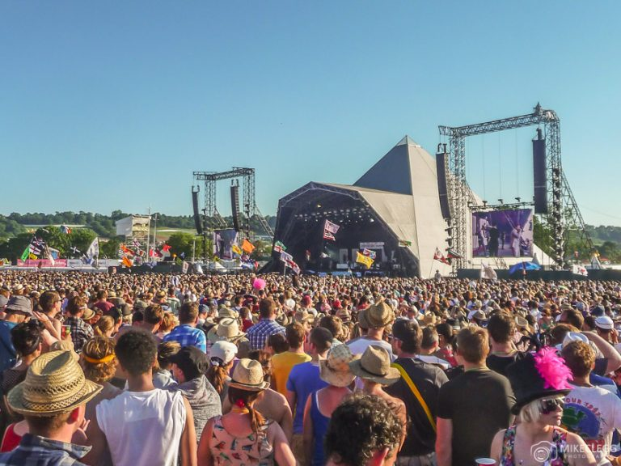
Music Festivals
There are different types of holidays in the world,
Music Festivals
During the summer months around the world there are various music festivals. They often span 3-5 days and offer a great line-up of music and entertainment. At many festivals you will be able to camp on-site in special areas which adds to the experience. A couple of awesome music festivals in Europe include Creamfields, Tomorrowland and Glastonbury.

Slide 3
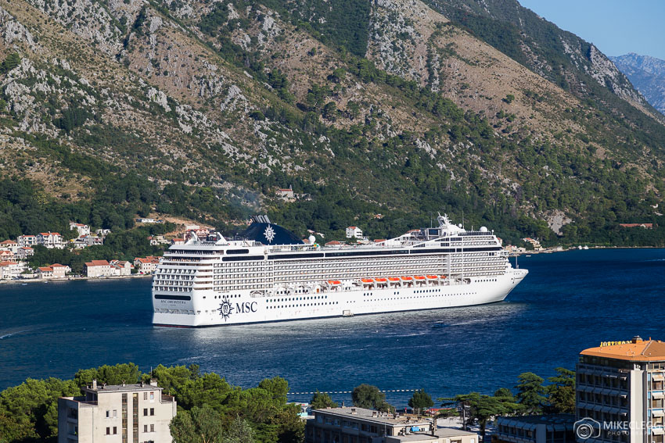
Cruise Holidays
A cruise holiday allows you to visit lots of destinations in one trip. The ship will often dock during the day at different places allowing you to jump off and explore. You then jump back on in the evening to head to the next place. Cruise trips tend to be quite expensive and luxurious, although there are more affordable options nowadays.

Slide 4
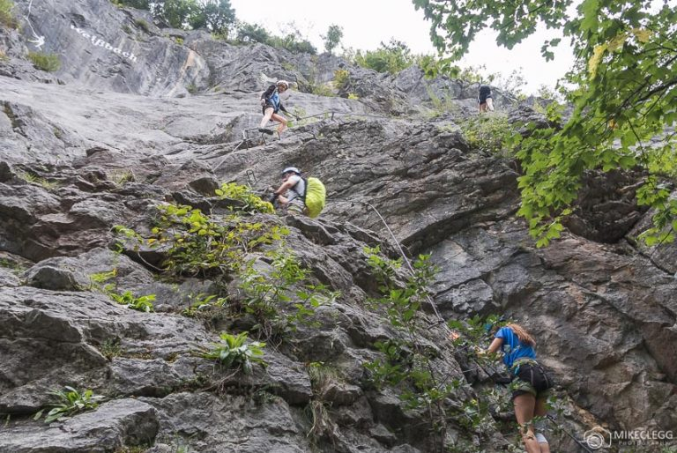
Adventure Holidays
An adventure holiday may include activities such as hiking, mountain biking, rock climbing, swimming, white water rafting and so much more. The best places for these types of holidays are often in rural locations, ie not cities. Head to my post Adventure Trips in Salzburger Saalachtal to have a read about one of my adventure trips.

Slide 5
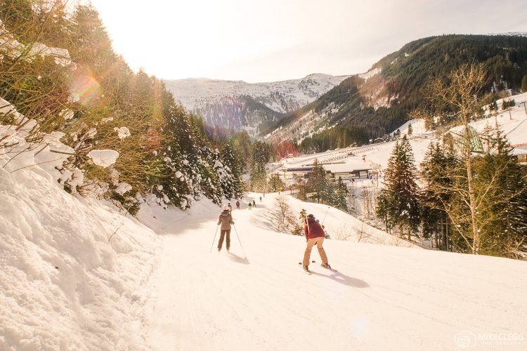
Skiing and Snowboarding
A ski and snowboarding trip is an active holiday in the winter months. These trips are often pricey and can sometimes seem like a luxury vacation. However they are fantastic holidays and for some reasons to go skiing and snowboarding check out my post 8 Reasons Why You Should Take up Skiing or Snowboarding.
There are now amazing resorts all around the world such as Lake Louise in Canada, Méribel in France and Bad Gastein in Austria. If you do go on a skiing or snowboarding holiday for the first time, then I recommend having lessons and also reading my Ultimate Safety Tips for Skiers and Snowboarders before you go.

Slide 6
Family Holidays
What makes the perfect luxury family holiday is, of course, very subjective. Here at HolidayDesire, we are sensitive to the fact that how precious family time is. Therefore, love to imagine ourselves as the experts for family friendly holidays and we offer numerous affordable family hotels that you can select from. We offer to you the one that will suit you and your kids hundred and one percent. Let your children bury their feet in the sands of Sharm El Sheik, Reus and Lanzarote; enjoy authentic cuisine in Mainland Spain and Balearics and drown in the festivities of Greece, Corfu, Crete and Rhodes. Frankly speaking, a family holiday is never complete without Paris Disney land, Rome, Venice or Turkey. We hold treasures of first-hand information that you simply can’t tag with a price and draw on thirty years of experience, with incalculable miles conjugated on our travel clock with sturdy supplier relationships. Entrust us with your prized family-time and we pledge to undertake every need and promise to go the extra mile to offer you with an exceptional and unforgettable family experience. With free child places, activities and amusements around the clock, and cheap hotels everywhere from Spain to Greece, we’ve got All-Inclusive family holiday to keep the whole gang on their toes. Time is extremely valuable to misuse, even more so when it surrounds your nearest and dearest, which is why we make sure every second of your luxury family holiday time well spent

Slide 7
If you can’t decide which destination to go to, check out our holiday types below.

Slide 8
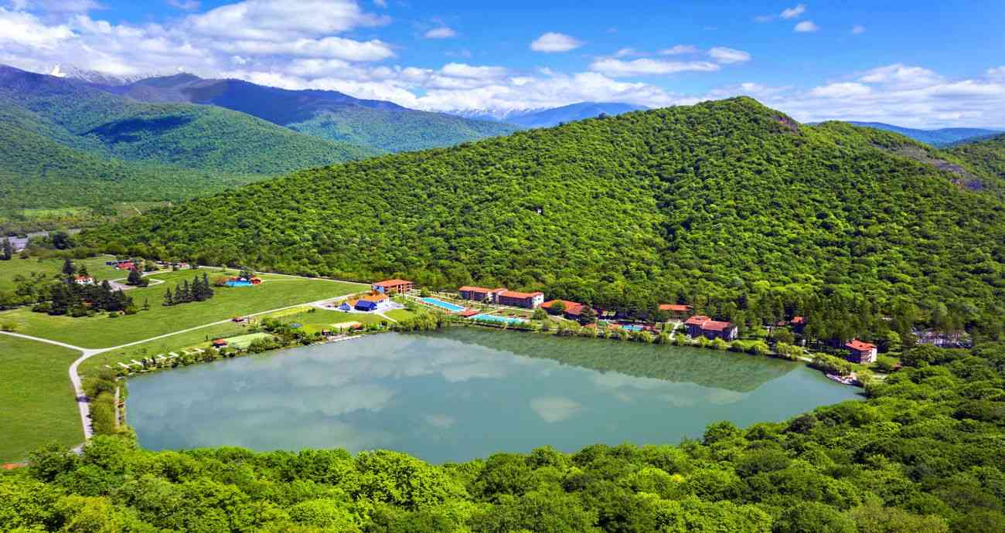
Lopota Lake Resort
Lopota lake Resort is one of the popular holiday destination’s in Georgia, which is located in Kakheti region and surrounded by the Caucasus mountains.
The resort is ideal for relaxation, family reunions, weddings, business meetings, entertainment and sports events.
Each season is beautiful with its breathtaking nature, beautiful Lopota Lake, contemporary hotel and unique atmosphere.

Slide 9
We engage our youngest guests at every turn, inspiring kids to interact with their environment and try something exciting. To find a place for all the fun at Lopota, we have created kids’ club - a space for little explorers and are ready to join them for adventures. Our professional nannies will keep the children entertained and help you to make the most of your stay.
Lopota Resort offers its guests a variety of entertainment options. Leisure facilities include bicycles and water bikes, billiards, table football, tennis and mini-golf. Lopota Resort also provides horse-riding tours in Lopota Valley, where guests have an opportunity to ride horses of a high breed while enjoying the beautiful natural scenery of the Kakheti region. Only Lopota Resort offers you the largest swimming venue.

Slide 10
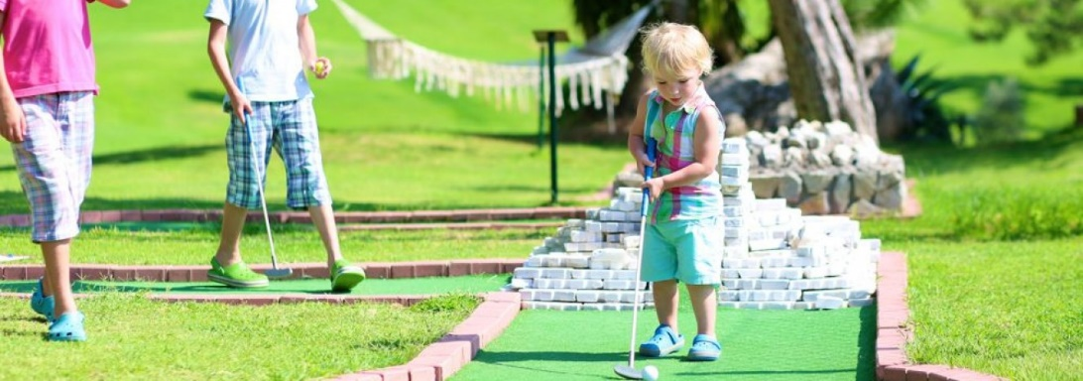
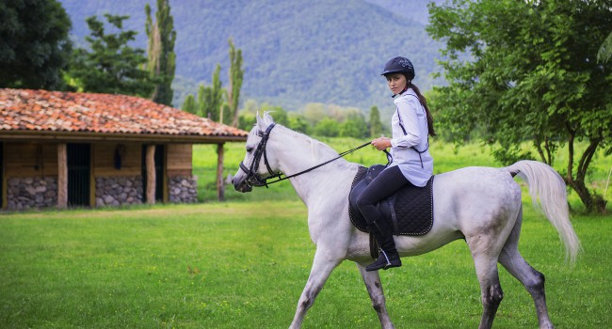
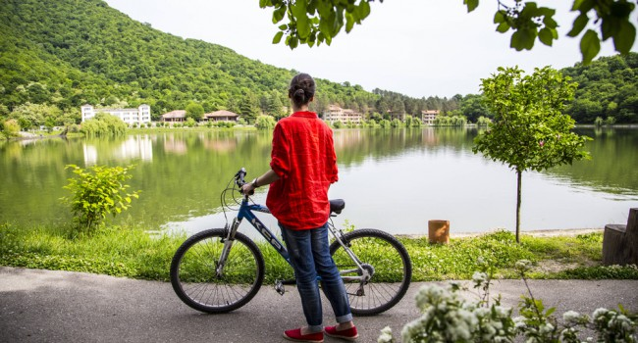
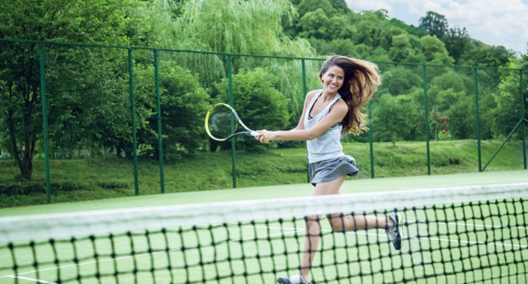
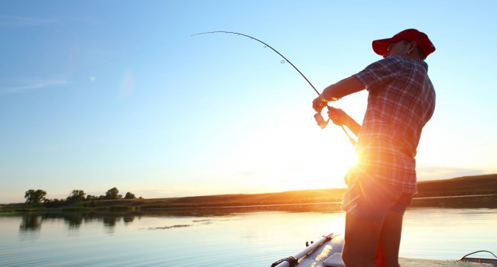
Lopota Lake Resort & Spa organizes annual 4-day corporate championship between amateur players. During the rest of the year, any guest can test their abilities on 2 professional courts.
Mini golf is one of the most amusing things you can do at Lopota Resort. The rules are simple and anyone can play, so don’t be shy!

